Slide 1
WANTED!
Alive or alive
ALISIA ZARBO – ENRICA ZANI
1° Year DHDK master degree
Digital Heritage and Multimedia course

Slide 2
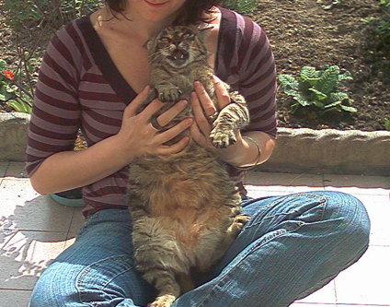
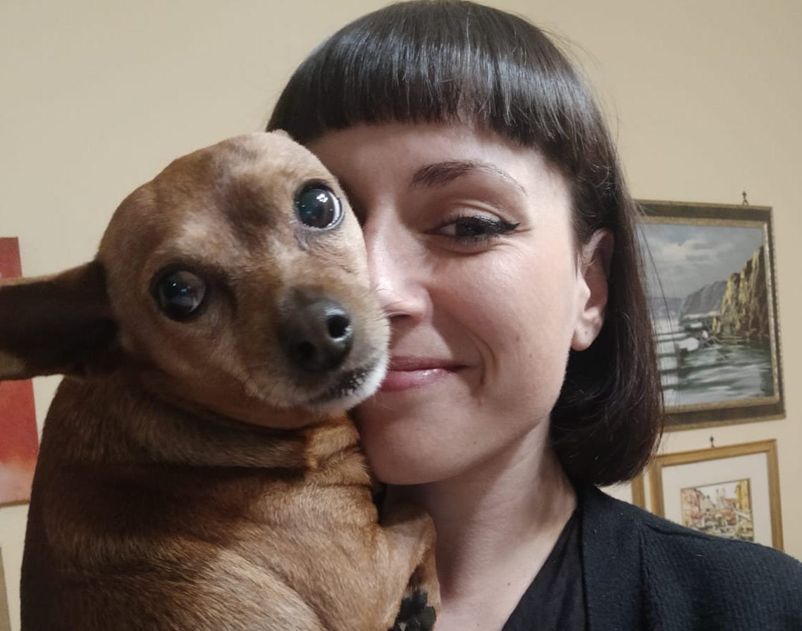
Team roles
Alisia Zarbo and Billy
Ideation cards museological approach; social media analysis; Personas; Scenarios with Twine; Virtual Frida's room with Blender; feasibility plan
Enrica Zani and Bigio
Basic idea and preliminary data section; physical museum analysis; Virtual Exibhition building with Omeka; application interaction diagram with Twine; mercandising ideation; privacy and copyright issues; bibliography

Slide 3
WANTED! > scaletta circa
The concept
The context analysis
Ideation cards
Museological approach
Personas and scenarios
Intro
The website
In Art – The Exhibit
3d Frida room
Choose yout Guide!
Evaluation form
Share your story
Merchandising
Forthcoming app
Preliminary data and Inspiration
Notes:
ugly duckling

Slide 4
WANTED! Alive or alive
Wanted! is a project that have been inspired by a corpus of lost-pets-advertisements photographs, collected by the authors over the years in various places.
It is focused on the complex relationship between humans and their pets in an anti-speciesist view of interpersonal relationship and family binds.
The name Wanted! comes from the strong visual relationship of these SOS-flyers with the Old West bandit bans even if, like the subtitle “Alive or Alive” explains, with different and opposite purposes and intents.
Notes:
ugly duckling

Slide 5
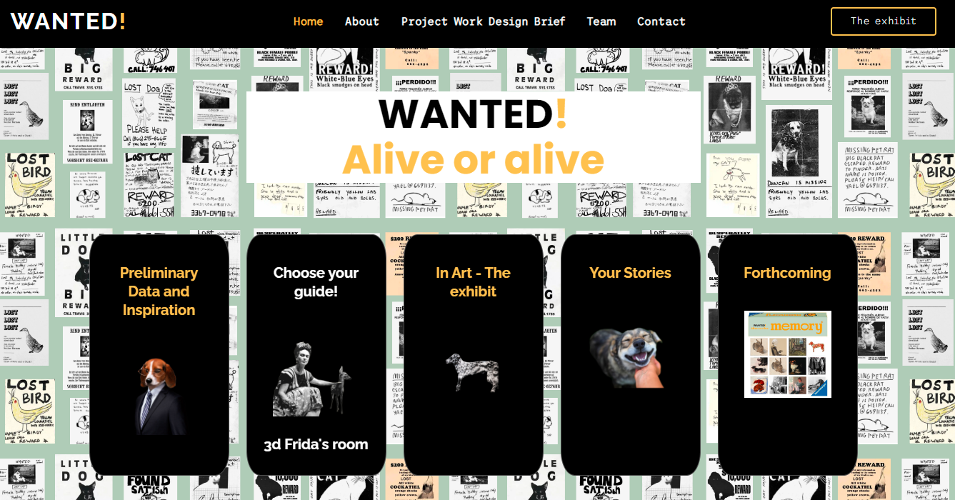
WANTED!
MI-FI PROTOTYPE
a growing souvenir-book built from users’ stories in the Your Stories section;
The website
The website https://enri-ca.github.io/WANTED/, is conceived as a multi-dimensional cultural environment offering different paths to be explored:
a Preliminary Data and Inspiration section to access data – such as the already mentioned corpus of lost-pets-advertisements photographs - analysed to realize the project;
a current virtual exhibition and its related interactive applications in the In Art – The Exhibit and Choose your guide and 3d Frida's room sections;
a preview of the developments in the Forthcoming section
Notes:
ugly duckling

Slide 6
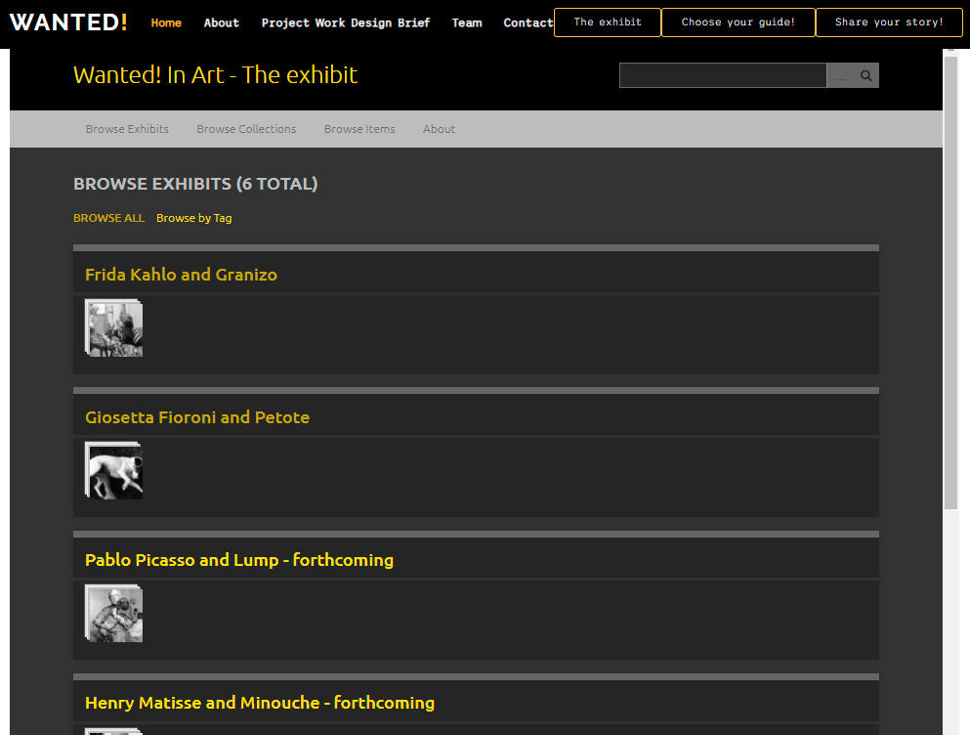
In Art – The exhibit
MI-FI PROTOTYPE
Virtual Exhibition
A virtual exhibition on the relationship of some artists and their pets:
6 artist’s paths:
Frida Kahlo and Granizo, Giosetta Fioroni and Petote (realized);
Pablo Picasso and Lump, Henry Matisse and Minouche, Salvador Dalí and Babou (forhcoming)
Tool: Omeka.net
Database of heterogeneous cultural objects, held by different institutions
DC description
Useful tool for museological paths
Notes:
ugly duckling

Slide 7
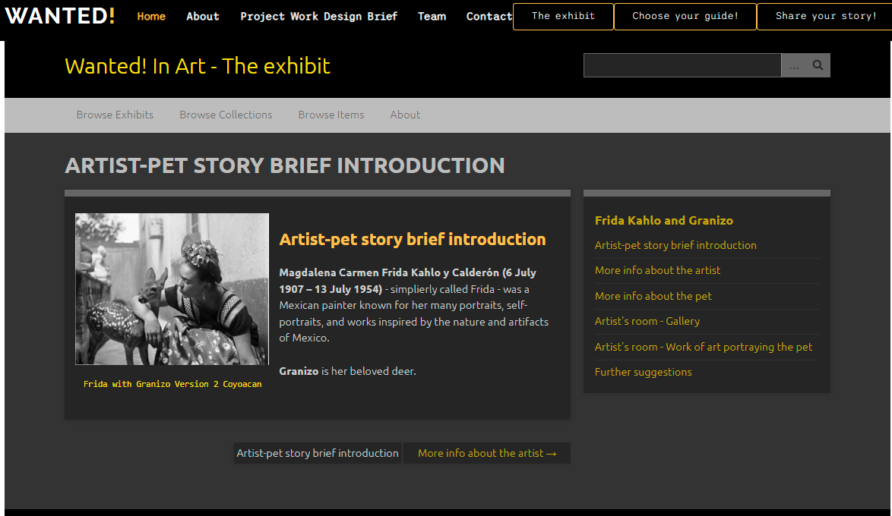
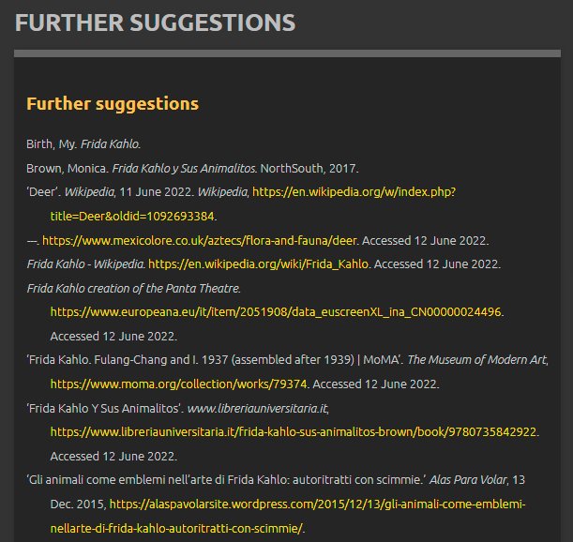
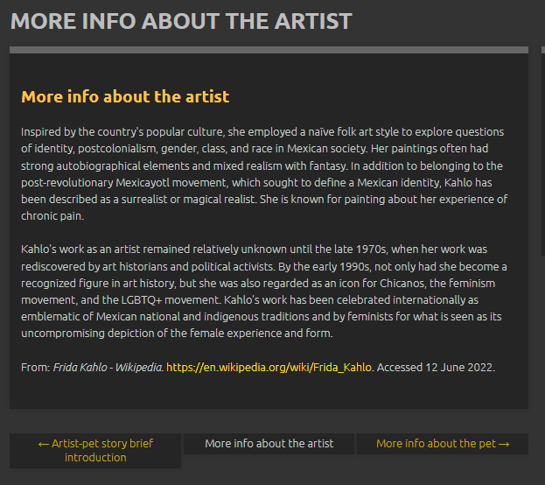
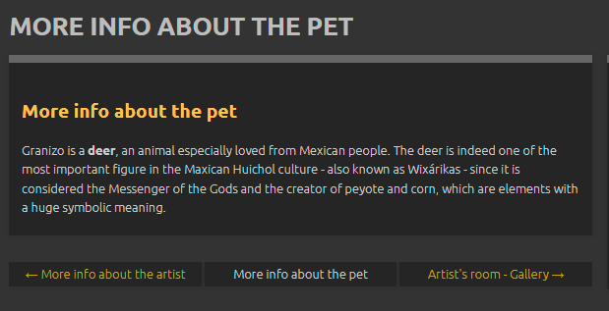
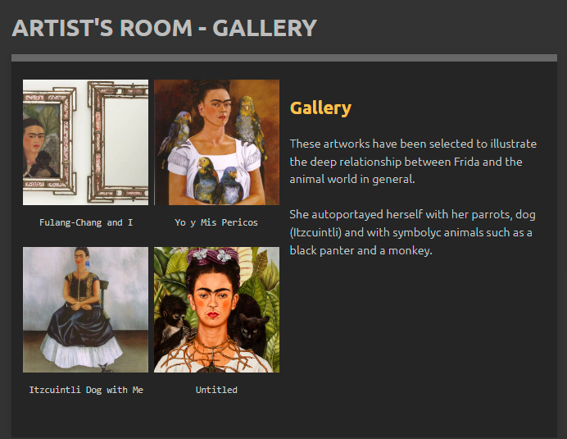
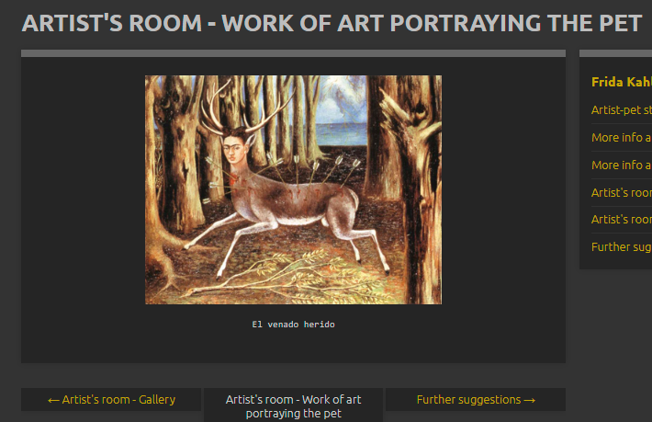
In Art – The exhibit
MI-FI PROTOTYPE
Virtual Exhibition
Notes:
ugly duckling

Slide 8
In Art – The exhibit
MI-FI PROTOTYPE
Virtual Exhibition
To be developed:
Use of original digital version of images in IIIF protocol
Use of original metadata of cultural objects with OAI-PMH
Creation of RDF data structure
Knowledge graph visualization and surfing
Real copyright respect
Different texts/languages/paths for different target audiences
Notes:
ugly duckling

Slide 9
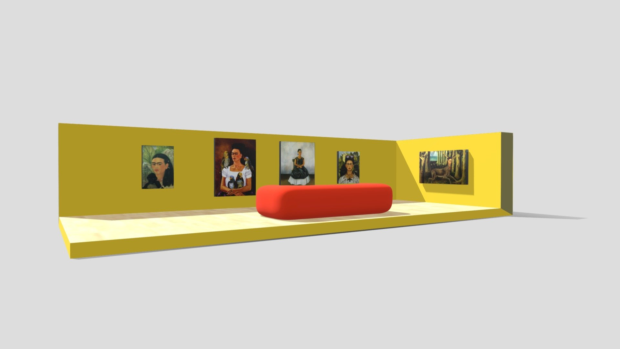
3d Frida’s room
MI-FI PROTOTYPE
Complementary material
INTERACTION
User capability of modifying the evironment and receiving a feedback from their actions, key element, togheter with
IMMERSIVITY
to realize presence – belief of actually being – in a VIRTUAL SPACE/EXPERIENCE
Interactive computer graphic
3d animation/Rendering
Format file
Sw used

Slide 10
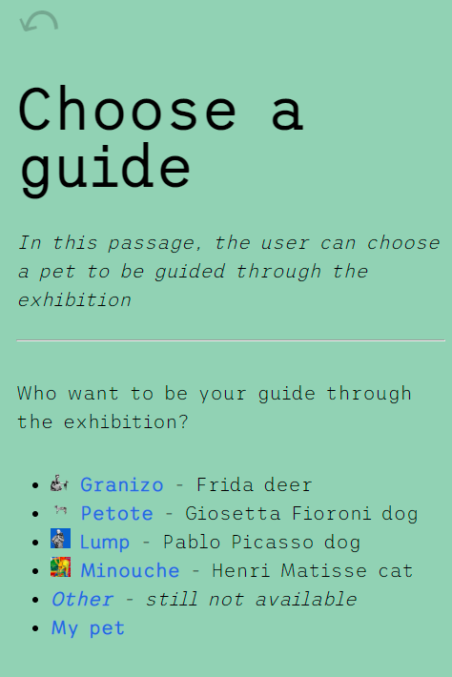
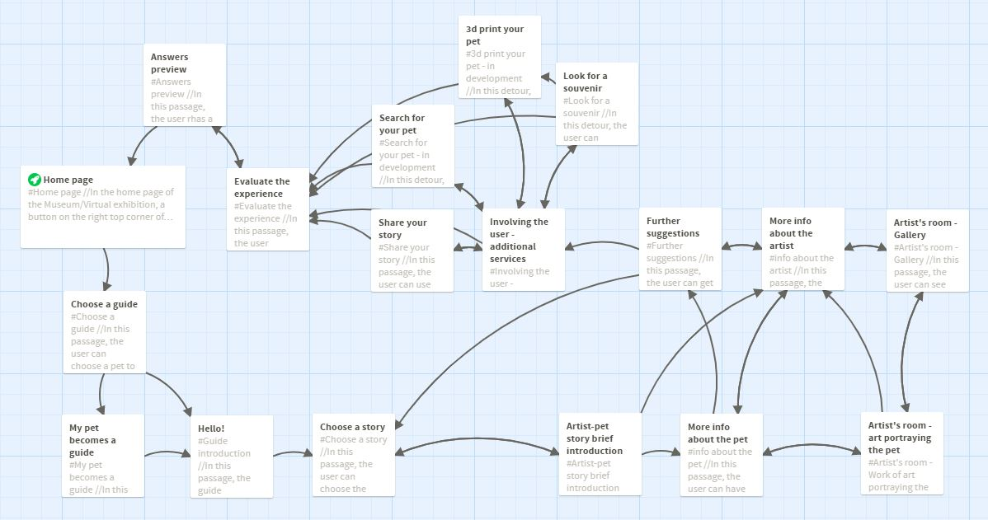
Choose your Guide!
Interactive application
CONCEPTUAL SCENARIO
NAVIGATION MAP
Notes:
ugly duckling

Slide 11
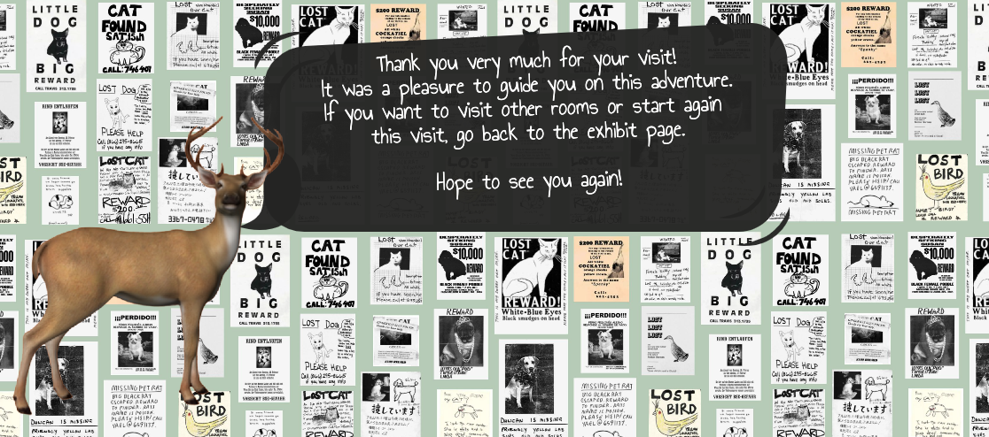
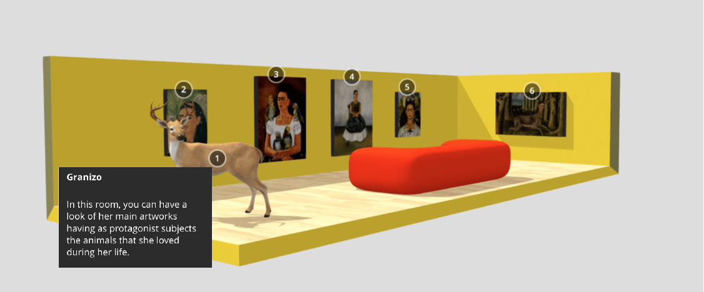
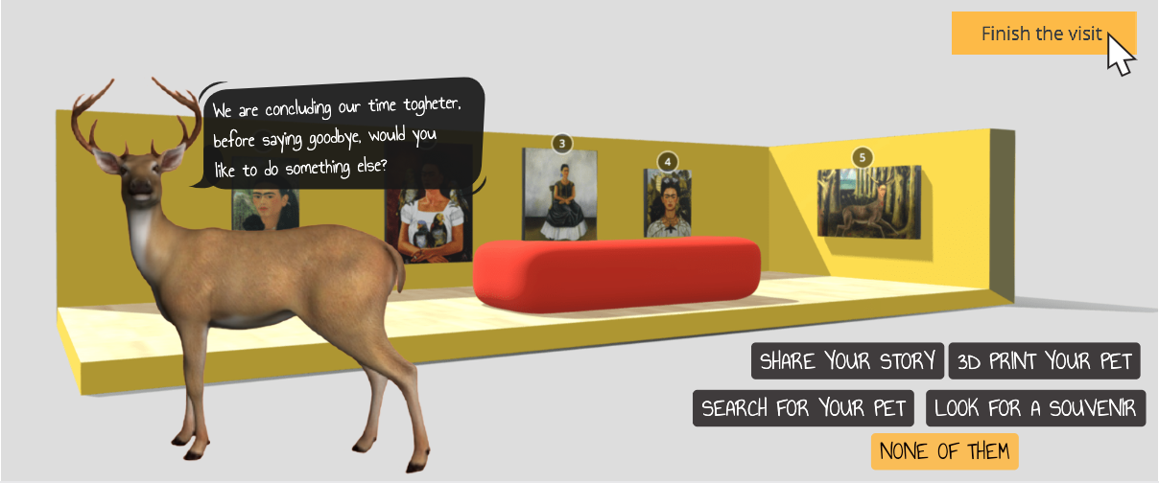
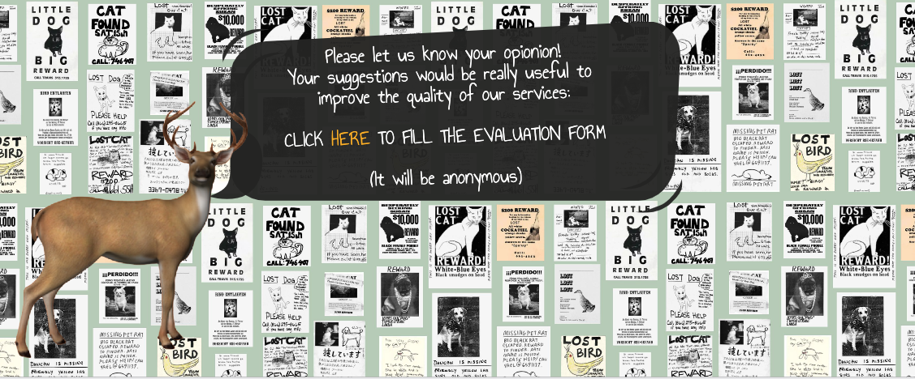
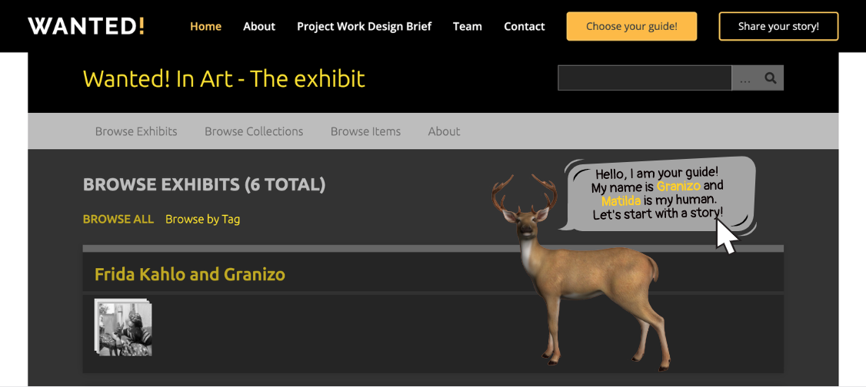
Interactive application
Choose your Guide!
STORYBOARD
NON-Interactive computer graphic
NON-Interactive computer graphic
3d animation
Format file
Sw used

Slide 12
Evaluation
Did you like the guide you have chosen?
How useful have been the contents you were told?
How much did you appreciated the final services offered ("Share your story", "3d print your pet", "Search for your pet")?
Overall, how much did yoy like the interactive experience?
Would you recommend this experience to other?
Free comments/suggestions/complains

Slide 13
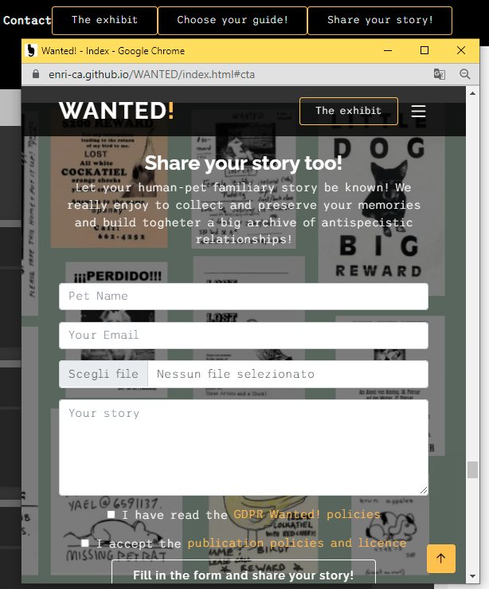
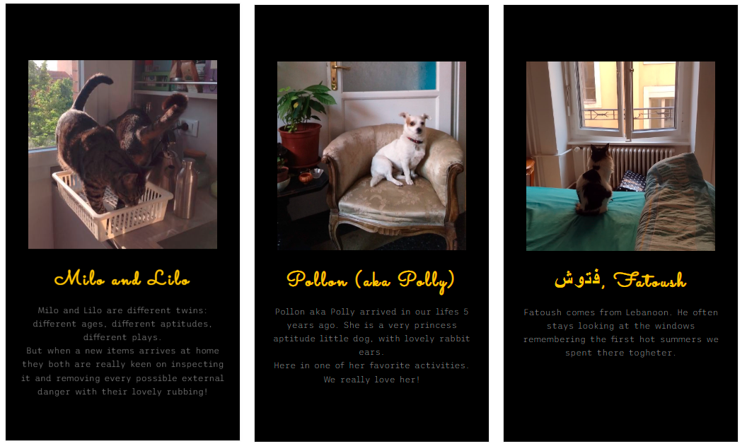
MI-FI PROTOTYPE
Engaging user
Share your story!

Slide 14
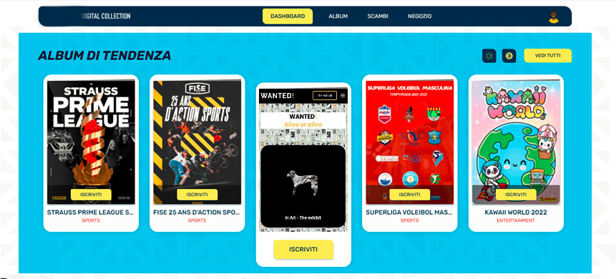
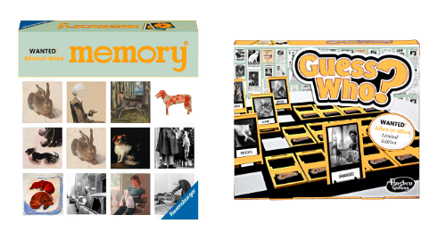
MI-FI PROTOTYPE
Engaging user
Merchandisign

Slide 15
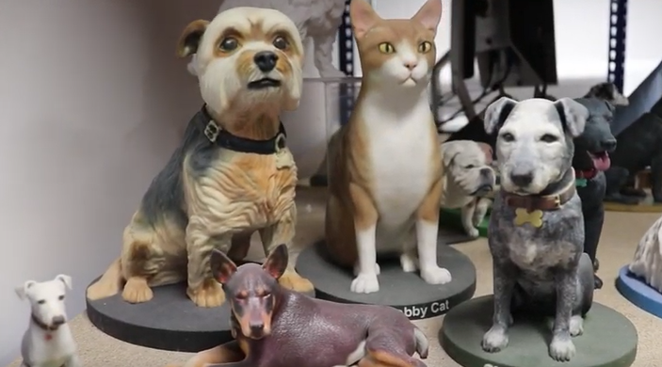
MI-FI PROTOTYPE
Engaging user
Forthcoming applications
3d print your pet
The idea is to develop a tool to realize a 3d printed little modelling of our pet, starting from uploading a 360° video. The merchandising unit will be in charge to realize and send home to the users the realized 3d print that will be used as a gift or a little celebrating statue.

Slide 16
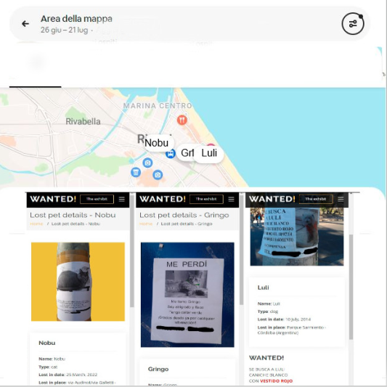
MI-FI PROTOTYPE
Engaging user
Forthcoming applications
Search for your pet!
Search for your pet is a tool able to help people who lost their pets by loading, sharing, and visualizing geolocated data of their missing pets. The user will have the possibility to fill in a form that will structure data similarly to those seen in the Preliminary data section; other users could improve information in case they have seen the lost-pet.

Slide 17
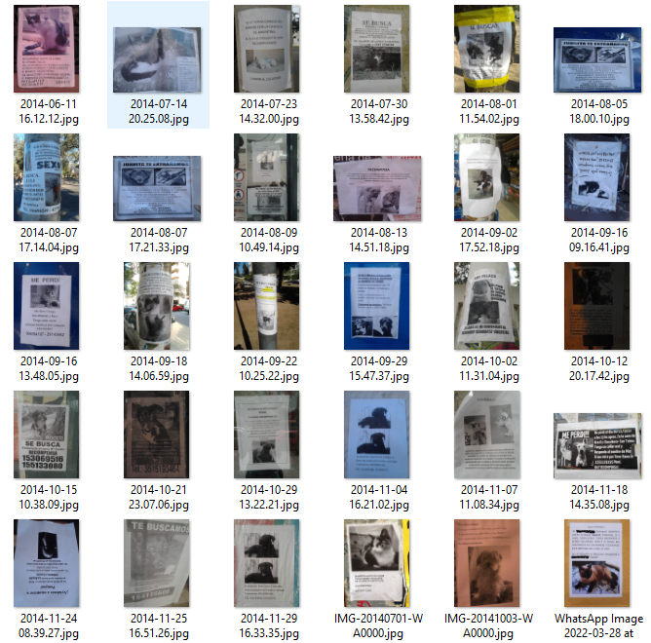
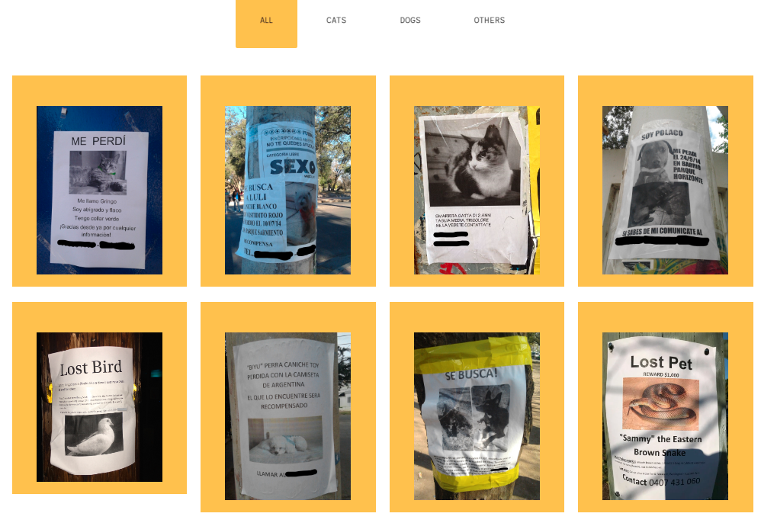
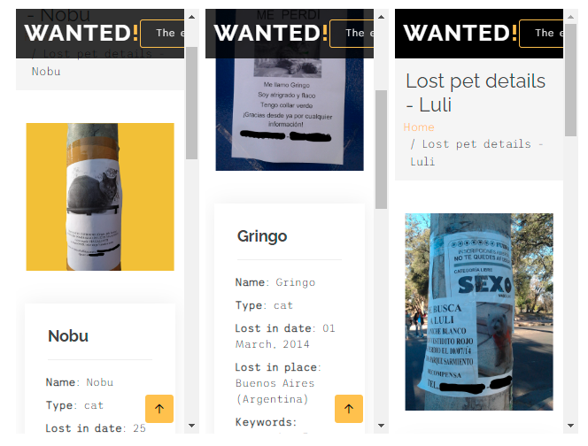
MI-FI PROTOTYPE
Preliminary data
Preliminary data and Inspiration

Slide 18
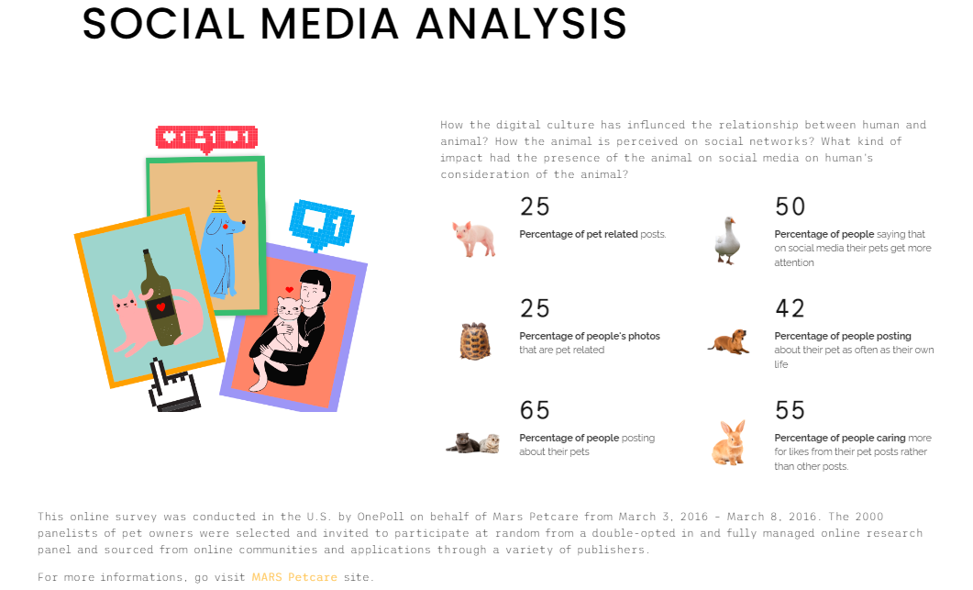
MI-FI PROTOTYPE
Preliminary data and Inspiration

Slide 19
How we arrive to define this project?
Context
Design cards
Goals
Museological approach
Personae
Scenarios

Slide 20
1. Preliminary brainstorming Corpus of lost-pets advertisements
Our starting point has been a corpus of photographs taken during the years in different places.
We were interested in these characteristics:
1. standard pattern of the visual construction
2. affective tie between the lost animals and their owners
3. power expressivity of the words used to describe the physical or behavioural features of the pet
4. personalization of the standard pattern/basic greyprint to give detaching details
Notes:
ugly duckling

Slide 21
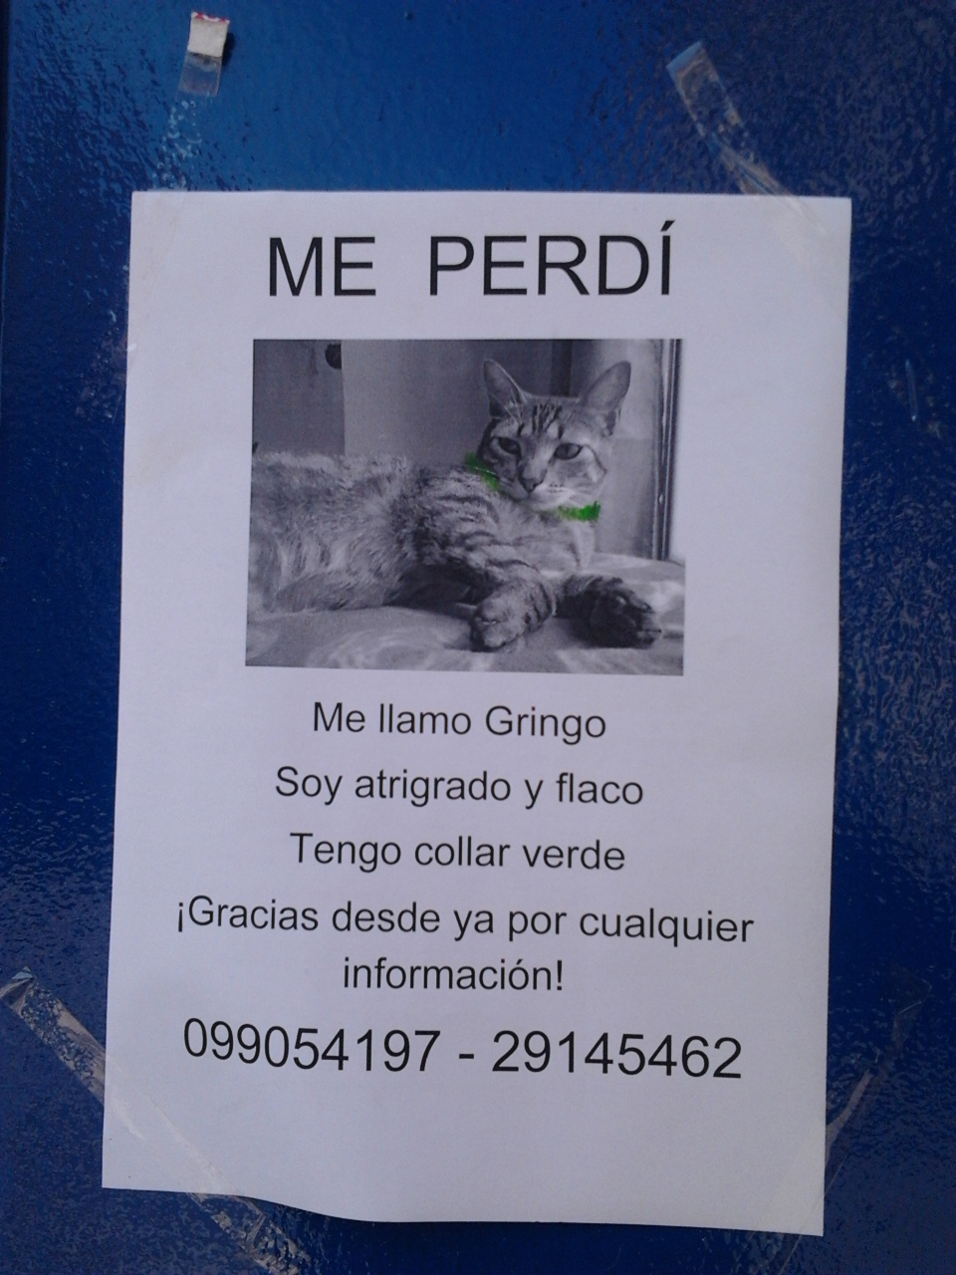
1. Preliminary brainstorming Corpus of lost-pets advertisements. Ex. 1
Our starting point has been a corpus of photographs taken during the years in different places.
We were interested in these characteristics:
1. standard pattern of the visual construction
2. affective tie between the lost animals and their owners
3. power expressivity of the words used to describe the physical or behavioural features of the pet
4. personalization of the standard pattern/basic greyprint to give detaching details
Notes:
ugly duckling

Slide 22
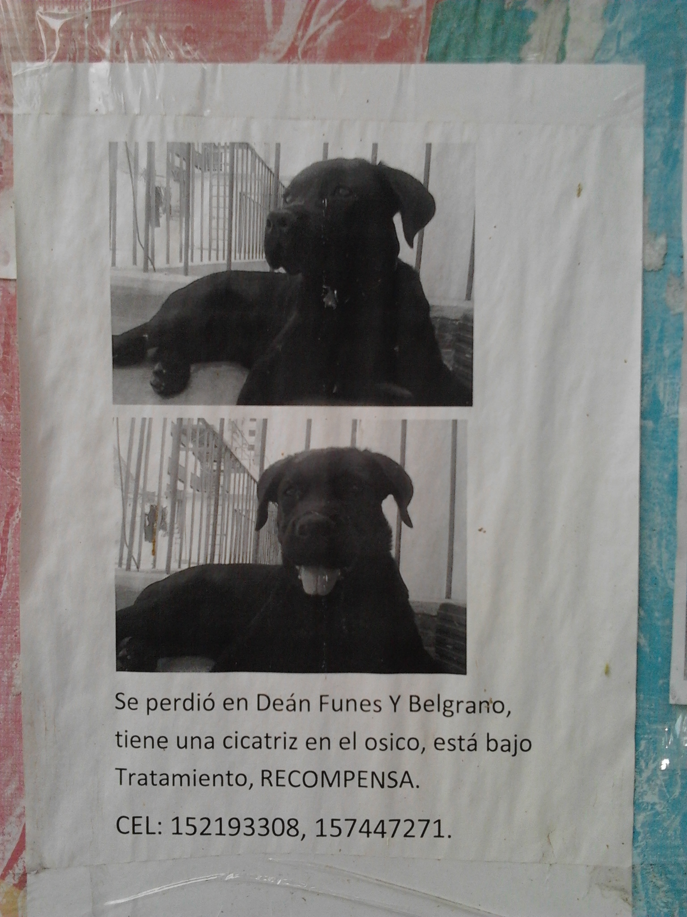
1. Preliminary brainstorming Corpus of lost-pets advertisements. Ex. 2
Our starting point has been a corpus of photographs taken during the years in different places.
We were interested in these characteristics:
1. standard pattern of the visual construction
2. affective tie between the lost animals and their owners
3. power expressivity of the words used to describe the physical or behavioural features of the pet
4. personalization of the standard pattern/basic greyprint to give detaching details
Notes:
ugly duckling

Slide 23
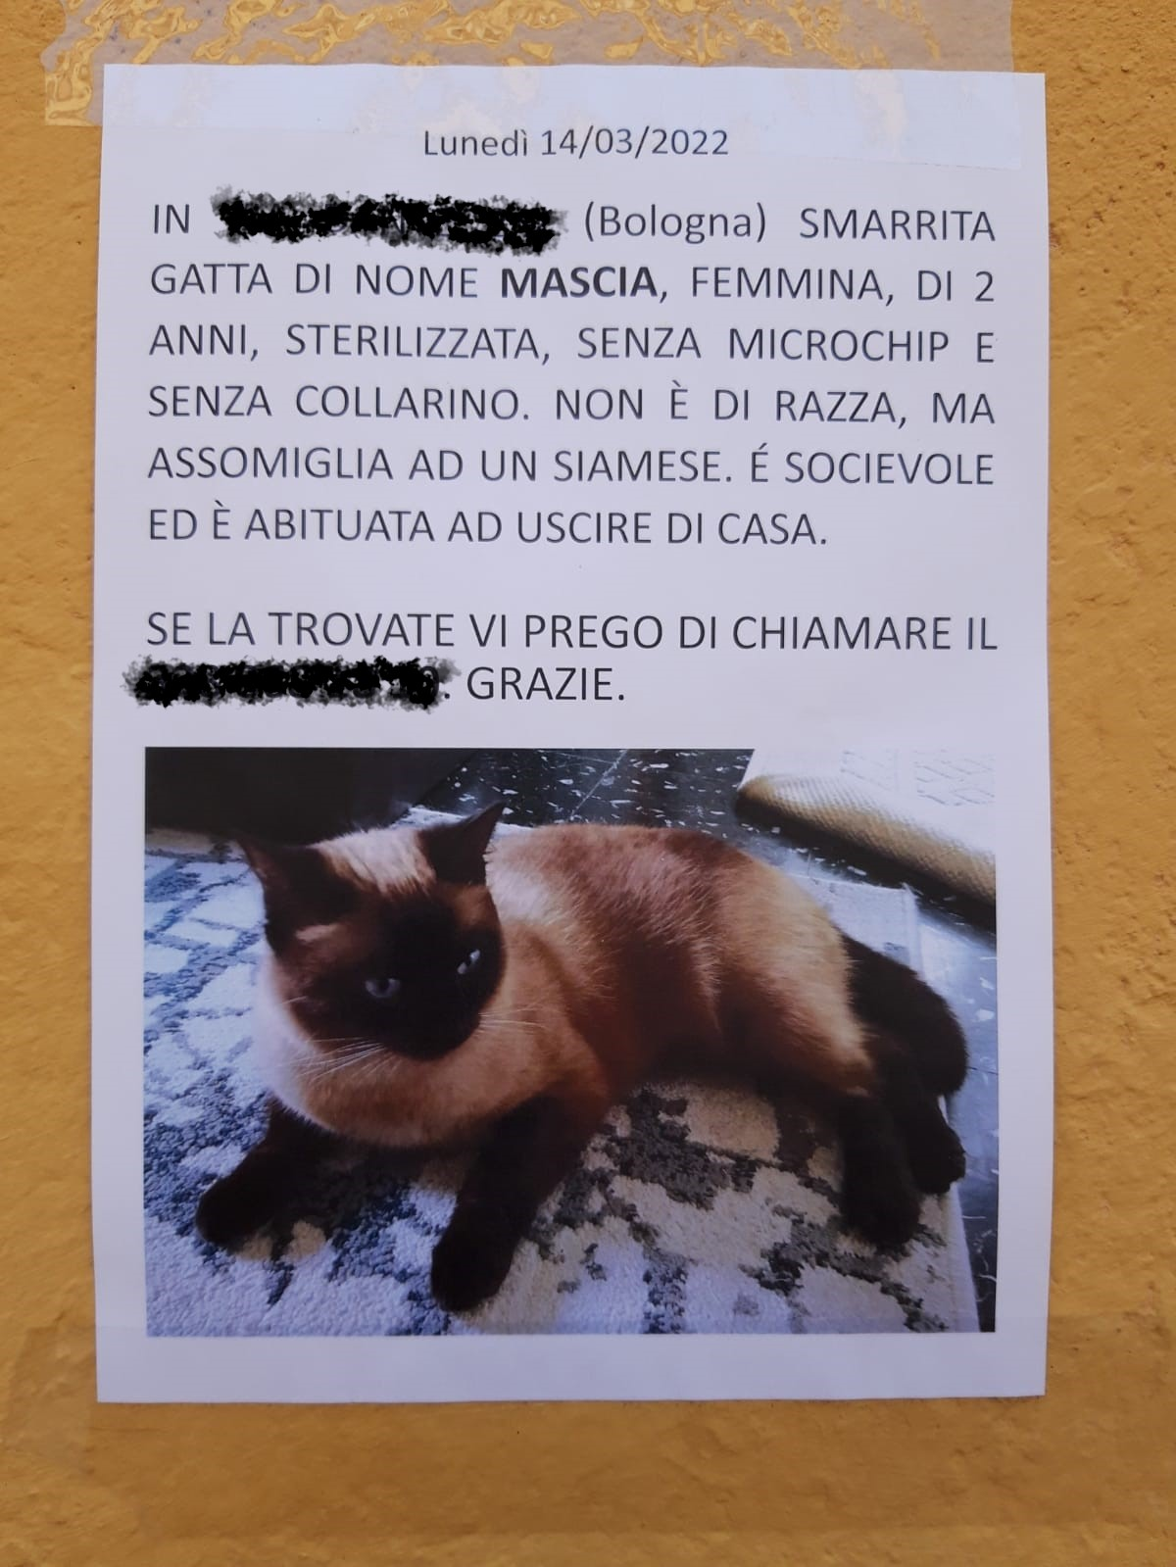
1. Preliminary brainstorming Corpus of lost-pets advertisements. Ex. 3
Our starting point has been a corpus of photographs taken during the years in different places.
We were interested in these characteristics:
1. standard pattern of the visual construction
2. affective tie between the lost animals and their owners
3. power expressivity of the words used to describe the physical or behavioural features of the pet
4. personalization of the standard pattern/basic greyprint to give detaching details
Notes:
ugly duckling

Slide 24
Benchmark on human-pet relation cultural institutions
We then started searching for cultural institutions devoted to the happier theme of human-pet relationship
We did a short and really lazy google search on «cat museum» keywords and use this offered result between the first 10 «17 Dog and Cat Museums Around the World»
Analyzing the 17 museums presented we find some recursive caracheristics as:
A lot of single-pet celebrating institutions
Run by private fundations or individual passionated
Often not technologically updated
Really devoted to passionated and amateurs target
Lack of high museographic standards
Lack of overall insitutions about anti-specistic view of interpersonal relationship and family's bounds
Scientific institutions e.i. Collezione di Anatomia degli Animali Domestici dell’Università di Bologna
Notes:
ugly duckling

Slide 25
PACT
It seemed to be useful, at this point, to proceed on the logical base of the PACT analysis together with the design cards.
And we started from people.

Slide 26
PEOPLE
TOOLS
Observations
Analysis of social behaviours
THE MATERIAL COLLECTED BY ENRICA SINCE 2014 (LOST PETS ADVICES)
PERCEPTION OF THE ANIMAL ON SOCIAL MEDIA (PET INFLUENCERS)
THE NEED FOR A PLATFORM WHERE TO PUBLISH AN ANNOUNCEMENT OF LOST PET

Slide 27
QUA DESIGN CARDS??

Slide 28
Real Cat museum(s)
The Cat Cabinet was founded in commemoration of the ginger cat John Pierpont Morgan (1966-1983). This special cat was the stubborn, headstrong companion of the museum's founder, Bob Meijer.
The museum is housed in the impressive, classically-furnished first floor - or piano nobile - which contains five rooms and is itself an attraction.
We choose as example the KattenKabinet (Cat Cabinet)
https://www.kattenkabinet.nl/
https://www.facebook.com/CatCabinet/
https://www.instagram.com/het.kattenkabinet/
Herengracht 497, 1017 BT Amsterdam The Netherlands
Tuesday to Sunday from 12:00-17:00
Context
The collection of the Cat Cabinet offers a wide look at the role of the cat in art and in culture through the centuries.
Neighborhood: Centrum
Amsterdam’s buzzing hub, with its sprawling network of tram rails and a seemingly constant flow of tourists and commuters, yields convenient access to some of the best sightseeing, shopping, and street life in Europe. Closest at hand are the Royal Palace, the quaint shops of Haalremmerdijk, the pedestrianized zones Kalverstraat and Dam Square with popular neighborhoods such as the Red Light District, and the Canal Ring hardly more than a moment’s stroll away. With the well-connected Centraal Station as Centrum’s base, it's easy to travel farther afield via one of the city’s iconic trams. (from https://www.tripadvisor.com/Attraction_Review-g188590-d196104-Reviews-The_Cat_Cabinet-Amsterdam_North_Holland_Province.html)
Notes:
ugly duckling

Slide 29
Real Cat museum(s)
We chooseD as example the KattenKabinet (Cat Cabinet)
Star Assets
Location
Art collection
Attention to interaction (early Virtual tour in flash)
Audience
Passionated and amateurs target
Art historian …
General tourist
Institutional goals
Renewal the communication and website
Attract new audience
Survive the fundator
Notes:
ugly duckling

Slide 30
DISRUPT DESIGN
AFTER OUR ANALYSIS WE CAME TO TE CONCLUSION THAT SOME ASPECTS OF OUR DESIGN WEREN’T TAKING INTO ACCOUNT THE REALITY.
P
A
C
T
THE TARGET PEOPLE CHOOSED FOR THIS DESIGN WAS RESTRICTED AND DIFFICULT TO INVOLVE IN A SCENARIO
IN A SO SPECIFIC LOCATION THE ACTIVITIES TO BE PROPOSED TO AN EVEN SPECIFIC AUDIENCE WERE NOT SO ATTRACTIVE
THE MUSEUMS THAT WE FOUND FOR THE DESIGN WERE FEW, SMALL AND REALLY PECULIARS.
THE TECHNOLOGIES THAT COULD HAVE BEEN INVOLVED WERE MANY; ON THE OTHER SIDE, THE CRITICAL ASPECTS SPECIFIED IN THE CONTEXT AND THE ACTIVITIES MADE DIFFICULT THE CORRECT INDIVIDUATION OF THEM.

Slide 31
2. Two case study Virtual exposition on artists-pets relationships
For a
Analyzing
then started
Star Assets:
…. …
…
Audience
Institutional goals
Motivations
Barriers
Capabilities
Devices
Notes:
ugly duckling

Slide 32
ENVISIONMENT
CONCEPTUAL MAP
Mettere immagine conceptual map
NAVIGATION MAP
Mettere primo design sito (ex modal etc)

Slide 33
CONCEPTUAL SCENARIO
STORYBOARD
Sezione storyboard con design cards (Sia Marco che Sofia)

Slide 34
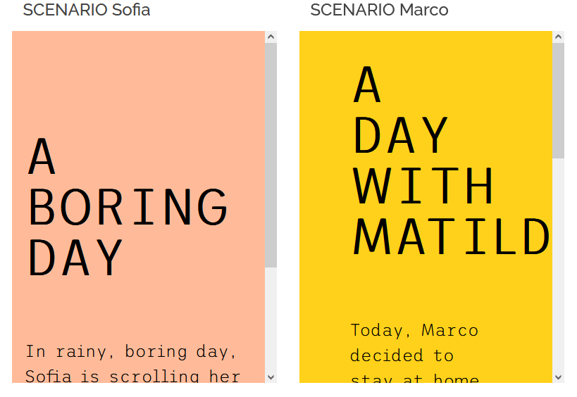
CONCRETE SCENARIO
SCENARIOS: STORIES about PEOPLE doing ACTIVITIES in a CONTEXT using TECHNOLOGY (PACT framework)
STORIES: taken from real life
CONCRETE SCENARIO: generalization with details of design
CONTEXT SCENARIO: how the application can best serve the needs of the persona
KEY PATH SCENARIO: how a persona uses/interacts with the application to achieve their goal/s

Slide 35
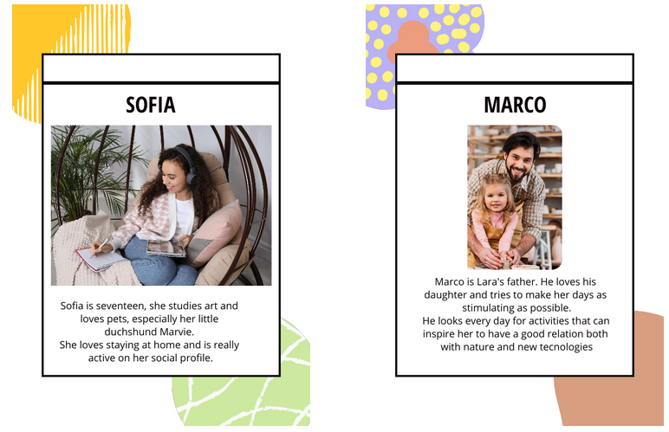
Scenarios and Personas
SCENARIOS: STORIES about PEOPLE doing ACTIVITIES in a CONTEXT using TECHNOLOGY(PACT framework)
PERSONAS (Alan Cooper, 1999)
Concrete representation of target users - based on real data collected: different type of people the I.A. is designed for
They have a name, background, goals and aspirations
ENGAGING PERSONAS: vivid description in involving stories, mix of
GOAL-DIRECTED: workflow, what my P wants to do with my I.A. to achieve their GOALS?
ROLE-BASED: behaviour/role, how my P will use my I.A.?

Slide 36
Scenarios and Activities
SCENARIOS: STORIES about PEOPLE doing ACTIVITIES in a CONTEXT using TECHNOLOGY(PACT framework)
SCOPE AND GOALS: what need/problem?
TIME: how long? Occasional/regoular? Calm or busy moment?
COOPERATION: alone/togheter?
COMPLEXITY: simple/well guided?
SECURITY: has potential impact?
CONTENT: what kind of data imput/output? What media?
Mettere la navigazione dello scenario e lo schema overall con gli snodi

Slide 37
Scenarios and Context
SCENARIOS: STORIES about PEOPLE doing ACTIVITIES in a CONTEXT using TECHNOLOGY(PACT framework)
PHYSICAL SPACE: how is it?
SOCIAL: alone/groups, backgrounds
ORGANISATIONAL: how the work environment, roles, management?

Slide 38
Scenarios and Technologies
SCENARIOS: STORIES about PEOPLE doing ACTIVITIES in a CONTEXT using TECHNOLOGY (PACT framework)
Which
MEDIA
DIGITAL CONTENTS (and how to acquire them)
HW-SW
ONLINE/OFFLINE/ONSITE
INTERACTIVE/NO
IMMERSIVE/NO
DEVICES
VISUAL/AUDIO?

Slide 39
PERSONAS/SCENARIO
DUE DIAGRAMMI CON PERSONAE E ANNESSO CONTESTO E ATTIVITA

Slide 40
Ideation cards for VE
AT THE END OF THE DESIGN PROCESS, AFTER THE DEFINITION OF THE PERSONAS TOGETHER WITH THEIR ACTIVITIES ACCOMPLISHED IN A CONTEXT WITH SPECIFIC TECHNOLOGIES, OUR PROJECT TOOK THIS SHAPE:

Slide 41
WHAT IF..?
INVOLVEMENT OF TWINE
DUE TO THE TOOLS IT OFFERS, WE FOUND TWINE A VERY POWERFUL WAY TO EXPRESS DIFFERENT POSSIBILITIES FOR OUR SCENARIOS IN A NARRATIVE BACKGROUND.
DIAGRAMMA TWINE MARCO
DIAGRAMMA TWINE SOFIA

Slide 42
COGNITIVE ASPECTS
WHICH COGNITIVE ASPECT OUR DESIGN TAKES INTO ACCOUNT?
EMPATHY
LANGUAGE and narrative
VISION
ATTENTION/DISTRACTION
AUTHENTICITY
MEMORY AND RECALL

Slide 43
TECHNOLOGIES FINAL DESIGN OF THE PROTOTYPE

Slide 44
NAVIGATION MAP
HOW WE DECIDED TO STRUCTURE THE PROTOTYPE SITE (cognitive analysis/UUX)
LITTLE SKETCH OF THE SITE’S LAYERS

Slide 45
Museological approach
The museological approach
We then started to think about the topic in a museological view trying to find the best way to translate it into a cultural journey.
Since the theme belongs to an emotional conceptuality, a good idea could be to express it through a story that accompanies the user as in a journey, articulated in simple steps repeated for every artist considered as:
1. A brief introduction on the pet artist story
2. More info about the artist
3. More info about the pet
4. The Artist’ room - Gallery: showing some of their work related to the human-pet bound
5. The Artist’ room - Work of art portraying the pet: showing the specific work of art
6. Further suggestions to know more about the topic

Slide 46
,,Museological approach
The Virtual Exhibition
We then created a “classic” Virtual Exhibition based on the Omeka.net free trial version, a tool that allowed us to create a database of work of art, collections, and exhibition path, as well as to propose to the user advanced tools for search and browse through the items proposed.
To this scope, we completed the museological path for two pilot artists – Frida Kahlo and Giosetta Fioroni – while we limited just to list other possible artist-pet relationship to be explored such as Pablo Picasso and Lump, Henry Matisse and Minouche, Dalì and Babou, etc.
The Interactive application and the 3d room
We also devised a more interactive application “Choose your guide” that give the possibility to explore the exhibition with a freer path but with the help of a proper guide, instead of being autonomous in reading the critical parts and linearly scroll the contents, and the guide will also suggest further activities at the end of the visit to engage more the user.
The visit is then divided in rooms, accordingly with the path of the Virtual linear exhibition, each of which is dedicated to a different artist and its bond with their pet and other animals. The virtual room is showed as a real museum room (walls, sofa, paints with panels), the paintings have an interactive panel trough which (by clicking it) the user can visualize the work and go into detail.

Slide 47
Museological approach
Virtual Exhibition and Interaction Application classification
The application, whose details will be discussed in the Development section, has then engagement and education as primary goals; our cultural environment can be classified in the E or F category, according to Simona Caraceni taxonomy:
E) Virtual museum that enhance museum objects INTERPRETATION with OPEN INTERACTION in an OPEN SPACE showing SELECTED (or ALL OBJECTS) of the museum collection, ALLOWING visitor CONTRIBUTIONS.
F) Virtual museum making EXPERIMENTS with NEW MUSEOLOGICAL MODELs with OPEN INTERACTION in an OPEN SPACE showing SELECTED (or ALL OBJECTS) of the museum collection, ALLOWING visitor CONTRIBUTIONS.
NEED Interpretaton - Experimentation/complex museum identity
INTERACTION Open
SPACE Open
CONTENT Selected works - Photograph, texts, geo-referenced material
VIRTUAL/REAL Virtual with real/Virtual with virtual
VISITORS CONTRIBUTIONS Allowed

Slide 48
Museological approach – I.A.
To classify the Interactive application proposed - Choose your guide - we used the V-MUST (1-8) and Hornecker-Ciolfi (9.1-9.3) classifications:
1. By Content human-pet affective relationship
2. By Interaction technology device-based, speech-based
3. By Duration basically short; depending on the user's choices
4. By Communication narrative, dramatization
5. By Level of immersion medium
6. By Format desktop and mobile, on line
7. By Scope education, engagement
8. By Sustainability to be analysed
9.1 Relationship to the Museum Environment-Space and Visitor Mobility: mobile interaction
9.2 Relation to the form of augumentation and experience: extended Reality: VR, fully artificial
9.3 Interaction beyond the physical visit post-visit: engaging the visitor; pre-visit: preparing visit

Slide 49
RECAP Envisionment techniques used
Scenarios
Storyboard
Navigation maps
Prototype (medium fidelity): concrete but partial representation or implementation of a system design
NO: blueprints, mood board, wireframes

Slide 50
10 golden rules
1. Maintenance: designed for target audience, context, time:
low level of new technologies to be adapt to low access and low maintenance;
updating > forthcoming;
re-using: museological path; private merchandising partnership for economic sustainability
accessibility: text-to speech
2. Integration: with people, place, context of museum
3. Co-design: Personas
4. Content: VALID, RELIABLE, TRACEABLE, TRANSPARENT digital assets
Research sources, documentation (p. 3-4 London Charter)
Historic rigorous, scientific transparency (p. 5-6 Sevilla Principles)
5. PoNR: 29/06/2022!

Slide 51
10 golden rules
6. GAP: between users-technologies-CH contents
Filled by WANTED! Metaphor and using Guide archetype
7. ENGAGEMENT: to attract attention, increase reflection, stimulating new toughts
Use of personal/familiar/popular
Playful dynamics
8. GENESIS:
GOAL
TARGET
9. DURATION: short to be connected with collection and contents, but longer if using further activities
10. DISSEMINATION:
Dissemination plan: by IG and social
Evaluation plan: users will be asked to assess the Interactive Application

Slide 52
4. Bibliography
https://enri-ca.github.io/WANTED/4.html#
Notes:
ugly duckling

Slide 53
Thank you for your attention!

